Slide 1
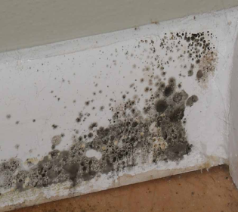
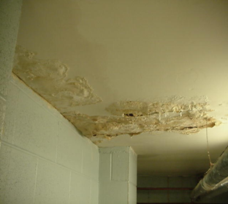
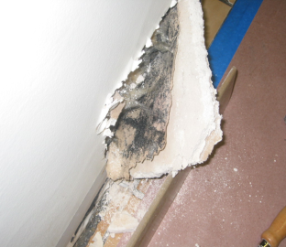
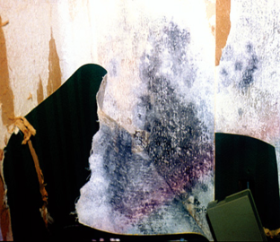
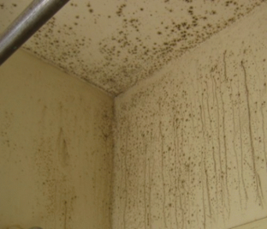
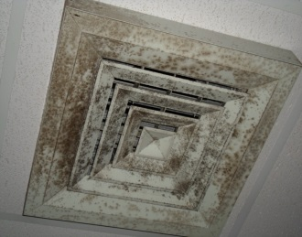
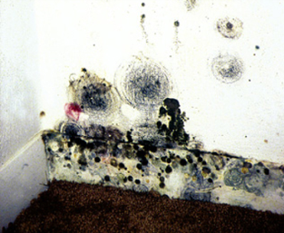
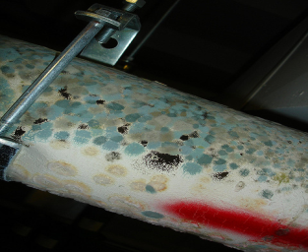
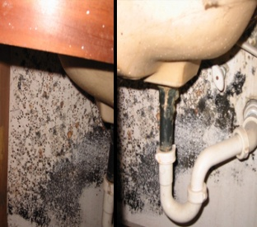
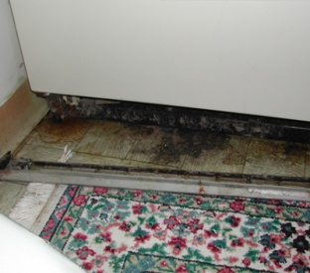
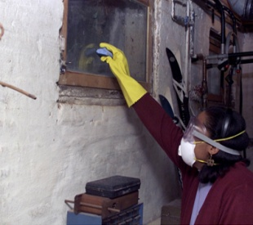
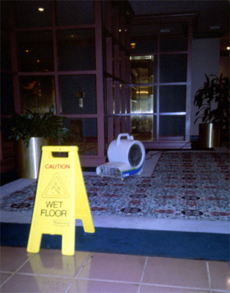
Mold Management Considerations
Photos courtesy of USEPA, Penn State, and others
Prepared for: Penn State Design & Construction Services
University Park
October 13, 2017
Prepared by: Hans Derr, CIH
OPP/EHS – Manager, Health & Environmental
Programs
Curt Speaker
OPP/EHS – Biosafety Officer

Slide 2
Mold Management Considerations Design & Construction Services
Overview
Mold Fast Facts
Design & Construction Considerations
General design/construction issues
Penn State D&C Standard sections
Mold Response @ Penn State – Internal vs. External
Resources
Penn State EHS website
Handout – Other information
Questions/ Follow-up

Slide 3
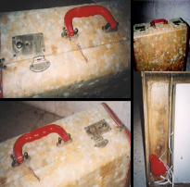
Mold Fast Facts
Single and multi-celled filamentous organisms:
300K+ species?
Nutrition from dead/ decaying organic (carbon-containing) materials require moisture for growth
Reproduction: Spores (like pollen), 2- 100 micron size
Moisture: critical to growth (humidity-water), vary by species
“Ubiquitous” (planet-wide, indoors, outdoors)
Growth: nearly any porous substrate
Health effects:
Spores allergenic
Produce odorous, irritating compounds – range of health symptoms
Produce toxins: Species-, environment-dependent; toxic in agricultural/ high concentrations, long duration (ACOEM, 2002)
Pathogenic (infect-growth): immune-compromised persons
Non-Biological Contaminants: Damp or wet building materials may off-gas other chemical irritants

Slide 4
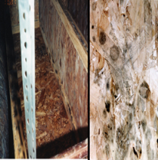
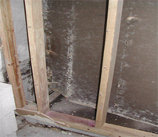
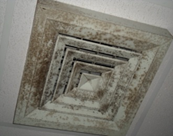
Mold Fast Facts
Growth degrades building materials, systems, AND indoor environmental quality
Effects may not be eradicated/abated in all materials; will eventually destroy substrate, therefore:
Control moisture – control mold growth
Uncontrolled indoor mold growth is never an acceptable operating condition
Health Complaints
“Black discoloration” – a perception AND real problem
Lead to: significant employee/ occupant concerns, ..
triggers: time-sensitive response expectations, ..
triggers: perception of faulty/failed response
triggers: OSHA complaints, ..
triggers: 40+ response hours (can exceed 120 hrs!)
Humidity Control
%RH > 65% significantly increases likelihood growth
%RH < 60% (others: 50%) significantly decreases potential growth
%RH Optimum: 30 – 60%

Slide 5
Design & Construction Considerations
General
OA intakes
Construction leaks
HVAC design and operability issues (one or more in combination)
Re-heat/ spatial condensation, humidity
Controls capability-planning: spatial temperature sensing,
Inadequate air movement
Filtration
Coil condition/cleaning: capability for access/ periodic PM’s
Fresh Air: Inadequate exchange OR Uncontrolled introduction thereof
Building pressure imbalances – incomplete-ineffective commissioning
Insulation Lining (NOT D&C OPTIONAL) REQUIRES EXCELLENT-EFFECTIVE:
Continuous, effective filtration
Reheat/ humidity control
Microbial resistance
Planned, periodic, preventive maintenance-cleaning

Slide 6
Design & Construction Considerations
General
Other interjecting factors:
Interior building/ biological sources
Porous materials spec’d in areas prone to humidity
Roof and envelope design/ ventilation
Design & Operation
Water incursion via:
Exterior Leaks: roof, windows, foundations (gray water)
Plumbing leaks: (Potable, Gray water, Sewage-black water)
Flooding (impacts by both sources)
Sprinkler activation

Slide 7
Design & Construction Considerations
General
Other interjecting factors:
Interior building/ biological sources
Porous specified materials in areas subject/ prone to humidity
Roof and envelope design/ ventilation

Slide 8
Design & Construction Considerations
PS Design & Construction Standards
Ensure Architects and Engineers familiarity with pertinent standard sections:
01 50 00 – Temporary Facilities and Controls
23 00 00 – HVAC Air Distribution
23 31 00 – HVAC Ducts and Casings
23 41 00 – Particulate Air Filtration
Avoid mismatches of finishes and building humidity control or operating features
Commissioning documents: operational/PM elements
Q/C critical features to avoid excess budget-focus (value engineering)
Manage construction to avoid temporary water infiltration
REFER to ASHRAE STANDARDS

Slide 9
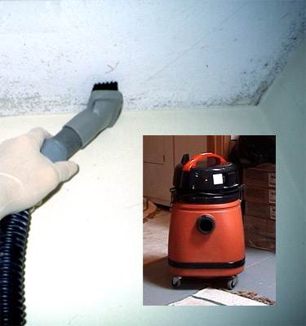
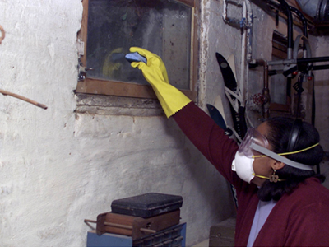
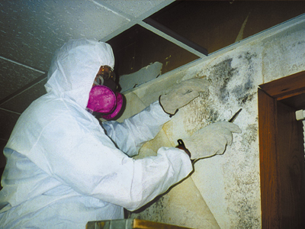
Like weeds, mold response may pose challenges

Slide 10
Design & Construction Considerations
Mold Response at Penn State: Internal vs. External
OPP Technical Services trained for custodial cleaning, and small-medium scale response
Custodial Cleaning (mildew, surface mold, limited scope)
Standard protective measure include eye, gloves, skin protection and application of cleaning/sanitizing solutions, damp control methods, respiratory protection voluntary – not anticipated
Small Scale (up to 3 square feet)
Area isolation, system shutdown, gloves, eye protection, disposable coveralls, respirator, HEPA vacuums, possible HEPA air filtration, spray mist/ damp work control, surface sanitize-wipe
Medium Scale (3 – 10 square feet)
All above plus HEPA air filtration
Large Scale (> 10 square feet)
Refer to outside qualified IICRC or ACAC Contractors utilizing pertinent IICRC or NADCA (HVAC) cleaning standards and protocols
Ultimate Decision by OPP with support/guidance by EHS

Slide 11
Design & Construction Considerations
Resources
Penn State EHS Website
https://ehs.psu.edu/indoor-air-quality/requirements-guidelines
Indoor Air Quality Standard Procedures (2014)
Mold Standard Operating Procedure (2014)
Water Incursion Guide (updated 2012)

Slide 12
Design & Construction Considerations
Resources
Handout/ Other Information
ASHRAE Standards:
62.1-2010 Ventilation for Acceptable Indoor Air Quality
55-2010 Thermal Environmental Conditions for Human Occupancy
0-2013 The Commissioning Process (2013 or updated)
188-2015 Legionellosis: Risk Management for Building Water Systems
Certified Servicer Training
Institute of Inspection, Cleaning, and Restoration Certification (IICRC)
Mold Removal Specialist or Applied Microbial Restoration Technician (alternate)
American Council for Accredited Certifications
Certified Mold Remediator (CMR)
Cleaning/ Remediation Standards:
ACR- The NADCA Standard for Inspection, Cleaning, and Restoration Certification of HVAC System (2013) http://acrstandard.nadca.com

Slide 13
Design & Construction Considerations
Resources
Handout/ Other Information
Cleaning/ Remediation Standards:
ACR - The NADCA Standard for Inspection, Cleaning, and Restoration Certification of HVAC System (2013) http://acrstandard.nadca.com
IICRC Standards:
S400 Commercial Built-Environment Cleaning and Restoration
S550 Commercial Structural Drying
S520 Mold Remediation

Slide 14
Design & Construction Considerations
Questions?
EHS Contact Information
Hans Derr (814) 863-3834 thd12@psu.edu
Curt Speaker (814) 863-3905 css2@psu.edu
EHS General (814) 865-6391
Bob Segura, Acting Dir. (814) 863-3874 ras78@psu.edu

Slide 15
Design & Construction Considerations
Presentation Support Slides

Slide 16
Prevention and Control of Mold Growth – General Guidelines
Prompt attention to water incursion
First 24 to 48 hours are critical
Effectively extract potable or gray water followed by steam cleaning
Clean mold from surfaces using wet methods or HEPA-vacuum
Use mist then HEPA vacuum to remove spores
NO dry-brushing or standard vacuuming
Do everything possible to limit the spread of mold spores
Final clean using sanitizer or disinfectant
Eliminate uncontrolled sources of moisture

Slide 17
Levels of mold response – to clean? …or not to clean?
For small spots on drywall, cinderblock (CMU), vent covers/diffusers, bathroom tile, other hard surfaces, lightly spray mold and wipe off
Porous items (paper, cardboard, ceiling tiles) – cannot usually be saved, unless very light growth
Cloth items can be laundered, if limited growth period
Carpeting should be HEPA-vacuumed, then steam- or hot-water/disinfectant extracted
Prompt drying is essential to prevent re-growth

Slide 18
Levels of mold response – to clean? …or not to clean?
Drywall – Localized spots can be cleaned/paint sealed
Drywall – Arrange for removal if swelling or deteriorating
Drywall or Plaster – Large areas (>10-15 square feet) or several smaller areas in a room require more area preparation and control, request assistance.
Insulation – If moldy, arrange for removal
Carpet – If carpet backing shows mold growth, or if not cleaned/sanitized within 56 hours, carpet should be discarded

Slide 19
Levels of mold response – to clean? …or not to clean?
Discard all items impacted by sewage water (black water)
Diffusers may be wipe-cleaned, unless extensive
Look for mold on internal duct surfaces
Avoid cleaning that require extensive movement of equipment or articles to access the mold
Obtain assistance before cleaning or removing extensively-impacted surfaces

Slide 20
Mold Response Guidelines
Mold Evaluation and Controls
NY City Department of Health (2008)
US Environmental Protection Agency
American Industrial Hygiene Association
Health Canada Guidelines
Mold Health Information
Centers for Disease Control and Prevention
PA Department of Health

Slide 21
Mold Response Guidelines
Mold Level I, Small isolated areas, generally < 10 square feet (OSHA Guide Abbreviated)
Corrective action by regular building staff with training in proper clean-up methods, personal protection, and potential health hazards. Training can be part of OSHA Hazard Communication Standard training. (29 CFR 1910.1200).
PPE/ Respiratory protection (e.g., N-95 disposable respirator) recommended with spore disturbance. Respirator use (voluntary or required) per OSHA respiratory protection standard (29 CFR 1910.134). Gloves and eye protection should be worn.
Work area unoccupied. Adjacent area personnel may remain, except: infants (less than 12 months old), persons recovering from recent surgery, immune-suppressed persons, persons with chronic inflammatory lung diseases (e.g., asthma, hypersensitivity pneumonitis, and severe allergies).
Containment not required. Dust suppression methods advised prior to remediation (such as misting/ not soaking). Possible HEPA vacuuming.
Contaminated materials that cannot be cleaned should be removed from the building in a sealed impermeable plastic bag; materials may be disposed of as ordinary waste.
Work area/egress cleaned with a damp cloth or mop and a detergent solution.
All areas should be left dry and visibly free from contamination and debris.

Slide 22
Mold Response Guidelines
Mold Level II, Mid-sized isolated areas, 10-30 sq ft.
(OSHA Guide Abbreviated)
Corrective action by regular building staff with training in proper clean-up methods, personal protection, and potential health hazards. Training can be part of OSHA Hazard Communication Standard training. (29 CFR 1910.1200).
PPE/ Respiratory protection (e.g., N-95 disposable respirator) recommended with spore disturbance. Respirator use (voluntary or required) per OSHA respiratory protection standard (29 CFR 1910.134). Gloves and eye protection should be worn.
Work area unoccupied. Adjacent area personnel may remain, except: infants (less than 12 months old), persons recovering from recent surgery, immune-suppressed persons, persons with chronic inflammatory lung diseases (e.g., asthma, hypersensitivity pneumonitis, and severe allergies).
Work area surfaces (that could become contaminated) covered with secured plastic sheet(s) before cleaning/ remediation to contain dust/debris and prevent further contamination. Note: possible HEPA air cleaner (not cited by OSHA)
Dust suppression methods advised prior to remediation (such as misting/ not soaking). Note: Possible HEPA vacuuming (not cited by OSHA).
Contaminated materials that cannot be cleaned should be removed from building in a sealed impermeable plastic bag; materials may be disposed of as ordinary waste.
Work area/egress cleaned with a damp cloth or mop and a detergent solution.
All areas should be left dry and visibly free from contamination and debris.

Slide 23
Mold Response Training
Mold response training providers and courses
Similar to those established for asbestos and lead abatement industry
Wet misting and wet methods to control dust
HEPA vacuums for collecting and containing particles
Bagging and sealing of contaminated waste (not asbestos-labeled)
Isolation measures (building HVAC, rooms, work areas, etc.)
Similar use of negatively-pressurized containments-work areas (large scale projects)
Primarily developed by Fire/Water Restoration industry
Certifying bodies, courses, standards include:
International Institute of Cleaning & Restoration Contractors (IICRC)
American Council of Accredited Certifications (ACAC)

Slide 24
Mold sampling, analysis & interpretation
General Requirements:
Requires specialized microscope, and a trained microscopist, and/or mycologist to positively identify molds
Primary Purpose:
Used to determine if mold is growing indoors or within building materials or equipment
Common Sampling/ Analysis Categories:
Air sampling
Surface sampling
Bulk sampling
Specialized sampling
Mold sampling is not used to confirm visible mold or visible damage

Slide 25
Mold sampling, analysis & interpretation
Mold sample analysis interpretation guidelines
Culturable air and spore sampling results compare indoor and outdoor mold types and concentrations
Types should be similar (generally)
Outdoor concentrations should be greater or similar than indoors
Salient differences in types may occur between outdoor and indoor areas where indoor water or microbial sources present (laboratories, kitchens, bathrooms, etc.)
Bulk sampling
Supports location or verification of air sample findings
Specialized sampling such as polymerase chain reaction(PCR)
Highly accurate DNA analysis to verify mold species
Locate or verify opportunistic pathogens

Slide 26
In Summary …
Visible surface mold does not mean that elevated mold levels are present in the air.
Mold sampling is not necessary to confirm visible mold or visible mold damage (seeing is believing).
Using the senses (visual, odor, dampness, etc.) still the best indicator of identifying an existing mold problem.
Mold can be safely cleaned, handled and controlled.
Apply appropriate skills and level of response to each situation. Obtain assistance with suspected extensive mold damage.

Slide 27
Mold Response Resources
Resources, certifying bodies, courses, standards include:
Organization | Resource(s) provided | URL - Website
USDOL/ OSHA | Safety & Health Information Bulletin- “Mold in the Workplace” (SHIB-03-10-10) | https://www.osha.gov/dts/shib/shib101003.html
USDOL/ OSHA | OSHA Mold webpage | www.osha.gov/SLTC/molds/
USEPA | Moisture Control Guidance for Building Design, Construction and Maintenance (EPA 402-F-13053) | http://www.epa.gov/iaq/pdfs/moisture-control.pdf
USEPA | Mold Course - "Introduction to Mold and Mold Remediation for Environmental and Public Health Professionals" | http://www.epa.gov/mold/ moldcourse/index.html
USEPA | Mold Resources webpage | http://www.epa.gov/mold/ moldresources.html
USEPA | Mold Remediation in Schools and Commercial Buildings EPA 402-K-01-001 (Sept. 2008) | http://www.epa.gov/mold/pdfs/moldremediation.pdf

Slide 28
Water Incursion through Ceiling

Slide 29
Water Incursion through a Wall

Slide 30
Roof Leak and Associated Mold Growth

Slide 31
Mold Growth is not always readily visible
Drywall beneath baseboard …and beneath wall paper

Slide 32
Mold on Carpet Backing

Slide 33
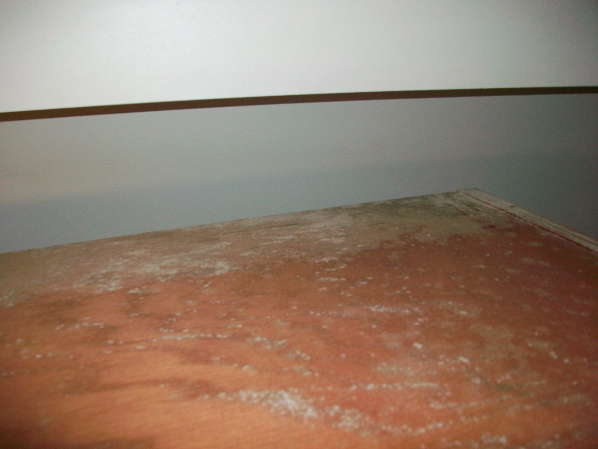
Mold on Subfloor beneath Carpeting
Begin considering …how might you respond?

Slide 34
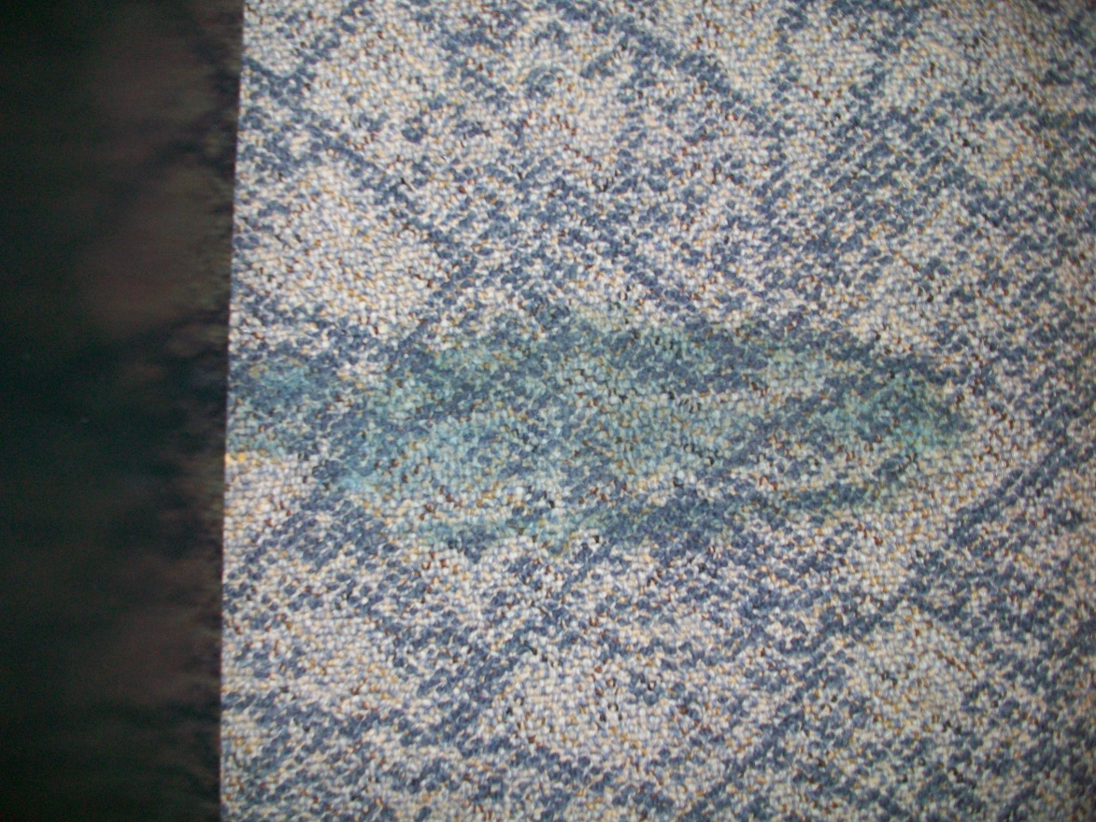
Mold Growth on Textiles
Mold, stains, or both?

Slide 35
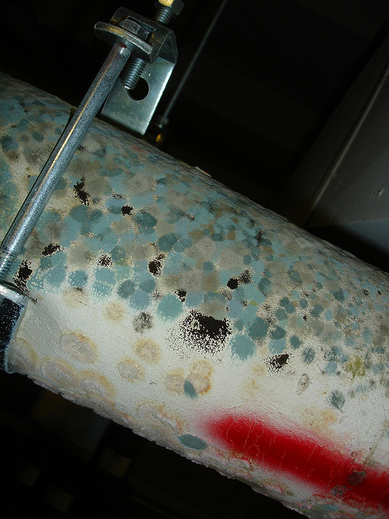
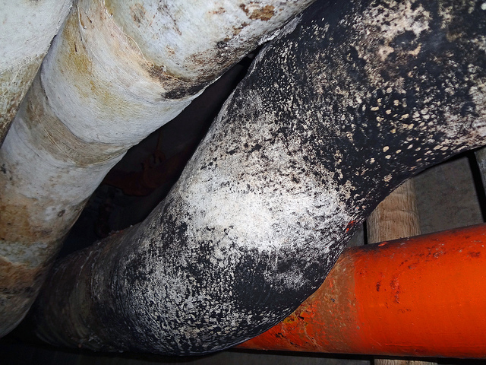
Mold on Pipe Insulation
Beautiful colors…
Water or humidity?

Slide 36
Mold on Pipe Insulation – Considerations
Pipe insulation may be moldy because:
High, uncontrolled humidity in the immediate area
Water incursion from area pipes has wetted the outer cover of the insulation
Pipe insulation improperly installed, allowing for cold/humid air to condense on pipe surfaces
Pipe hanger has crushed insulation, making pipe or hanger vulnerable to condensation
Pipe(s) are leaking…water running inside pipe, and penetrating insulation

Slide 37
Mold Growth related to Ventilation Systems
In Ductwork
On Diffusers

Slide 38
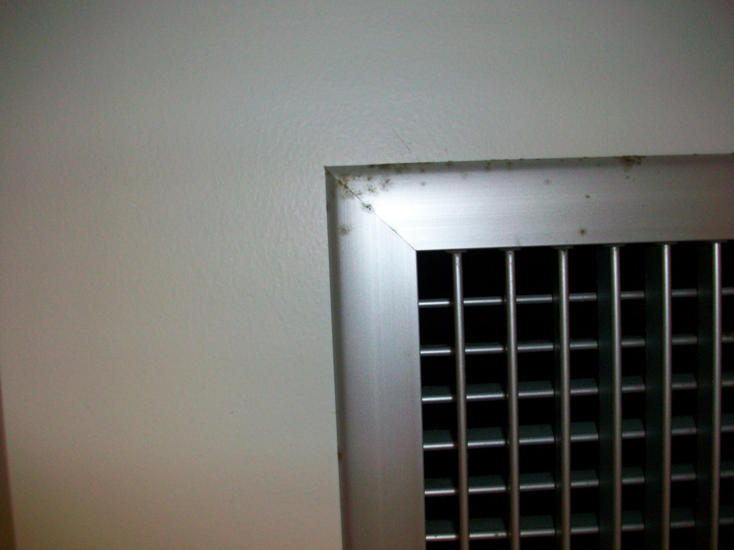
Mold Growth related to Ventilation Systems
What are we seeing?

Slide 39
Humidity-Related Mold
Bathroom mildew
On Diffuser from condensation

Slide 40
High, Uncontrolled Humidity
Unwanted increase of humidity in an indoor environment or building
May follow a water incursion event with incomplete drying and ventilation of the area
Usually associated with poorly ventilated areas
HVAC system malfunctions
HVAC system limitations (limited air exchange)
e.g. North Halls
Condensation on cold room surfaces

Slide 41
Moldy pipe insulation or asbestos-containing material considerations
Methods to control spread of mold are similar to those used with asbestos
No dry removal
Thorough wetting of surfaces
Minimize handling of material
Area isolation for larger jobs
Respiratory protection & PPE
Type of insulation not a significant factor (except asbestos)
i.e. disposal requirements

